Slide 1
Cryogenic Equipment – Part II
(content courtesy: Tom Peterson/SLAC)
Ram C. Dhuley
USPAS – Cryogenic Engineering
June 21 – July 2, 2021

Slide 2
Outline
Cryogenic equipment
Mechanical cold seals
Pressure relief valves
Photo stories
Feed box fabrication sequence
LCLS II SRF cryomodule assembly

Slide 3
Metallic cold seals
The Fermilab Tevatron includes about 1200 interconnects (magnet-to-magnet and magnet-to-endbox), each of which includes
An insulating vacuum to beam vacuum seal
A 4.0 K, 2 bar helium to vacuum seal (“single-phase seal”)
A 4.0 K, 1.2 bar helium to vacuum seal (“two-phase seal”)
An 80 K, 3 bar nitrogen to vacuum seal

Slide 4
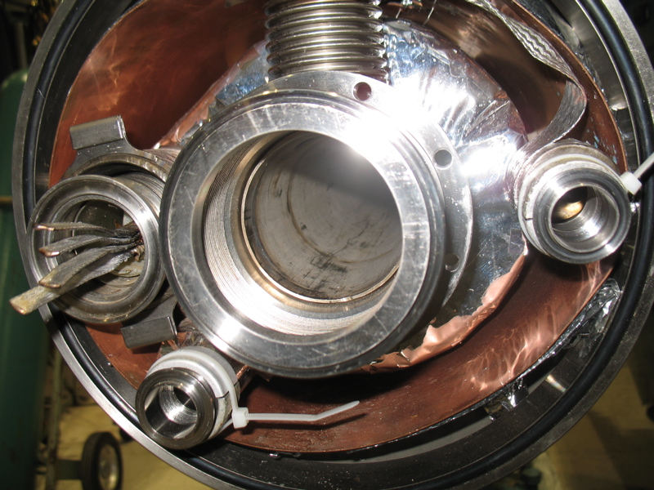
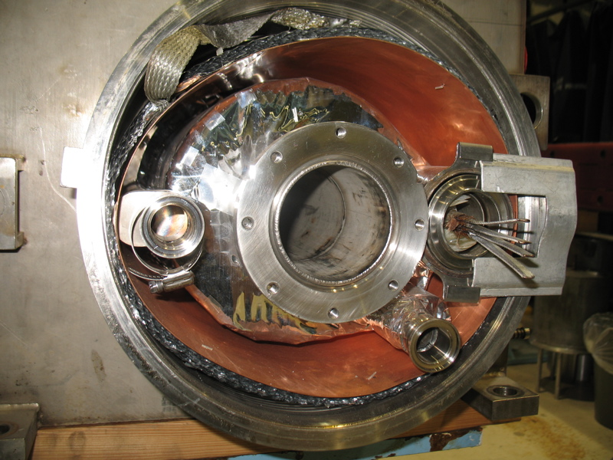
Metallic cold seals
Tevatron magnet interconnect (one side)
Beam tube
Nitrogen
2-phase He
Single-phase He
Other side of interconnect

Slide 5
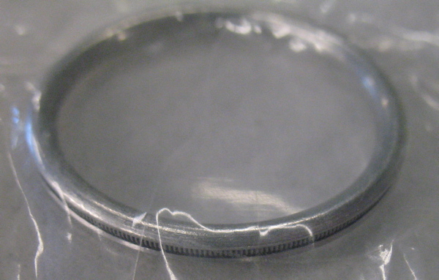
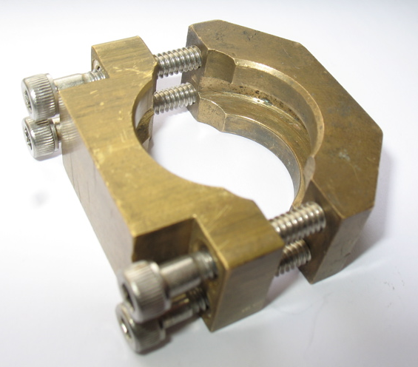
Metallic cold seals
Seals for nitrogen and 2-phase helium lines
Aluminum Helicoflex c-seal with internal inconel spring. Surface finish of flange is about 80 micro-inch (2 microns). Seal is designed specifically for this finish.
Fermilab-designed brass
wedge clamp -- we like these brass wedge clamps at Fermilab

Slide 6
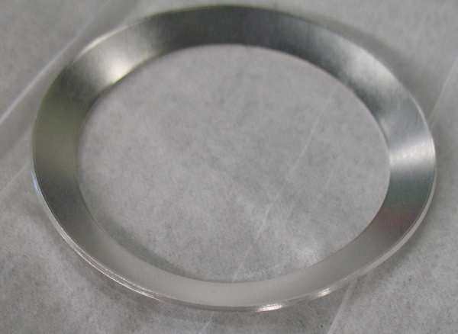
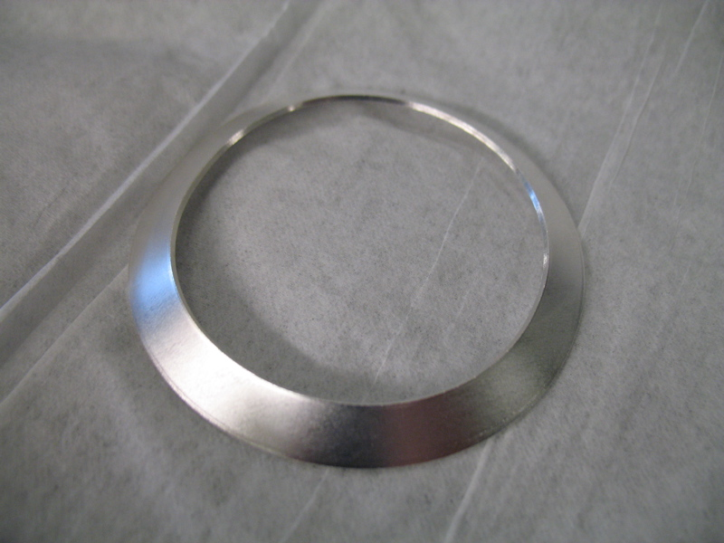
Metallic cold seals
Seals for single-phase helium
Stainless steel, elliptical “Conoseal” from Aeroquip Corp.
Silver coated 0.0005” (13 micron) thick plating. Coated locally.
Indium, copper, and gold plating each failed. (Indium creeps, gold had poor adhesion to the SS.)
Good success with silver, although if the silver corrodes, then it leaks.
Similar 4-bolt Fermilab-designed brass clamp on tapered flanges.

Slide 7
Metallic cold seals
Some concluding remarks
Indium is popular but not universally endorsed for helium to vacuum metal joints
Indium seals used successfully for SF to vacuum seals at Fermilab’s Magnet Test Facility
Tevatron experience suggested creep and long-term failure
Indium seals used extensively at Jlab for long-term seals (See paper by Benesch and Reece, Advances in Cryo Engineering, Vol. 39A, pg 597)
A very sensitive and successful leak test generally results in a leak tight SF seal. Such a leak check requires a local test fixture around the seal or double-seal.
“Cold leaks” (4.5 K) may be found which are likely just due to greater He density and leak rate cold.

Slide 8
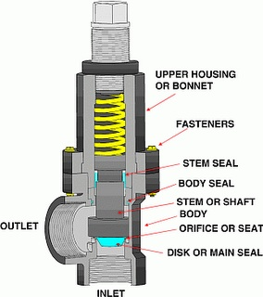
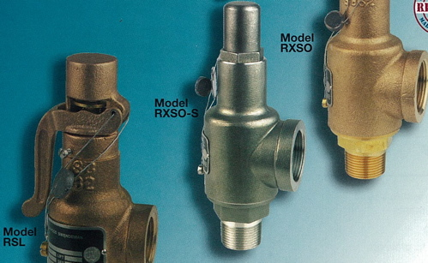
Spring loaded relief valves
Spring loaded valves are routinely used to relief excessive
pressure in helium piping or on a helium bath

Slide 9
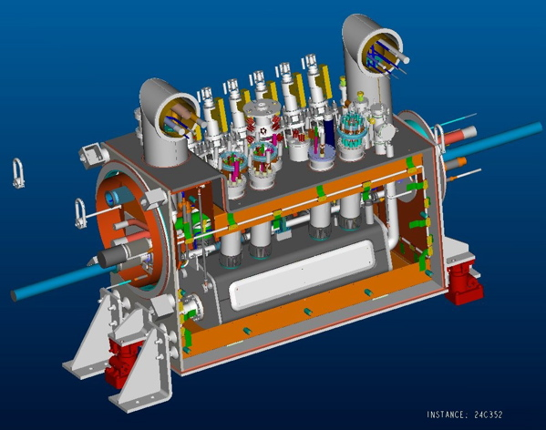
Photo story 1 - Fabrication of a magnet current “feed box”
The following photos illustrate the sequence of major steps in fabrication of a large cryogenic box in industry
A “distribution feed box” or DFBX for the inner triplet magnets in LHC
Eight boxes fabricated at Meyer Tool near Chicago and shipped to CERN
Ram C. Dhuley | USPAS Cryogenic Engineering (Jun 21 - Jul 2, 2021)

Slide 10
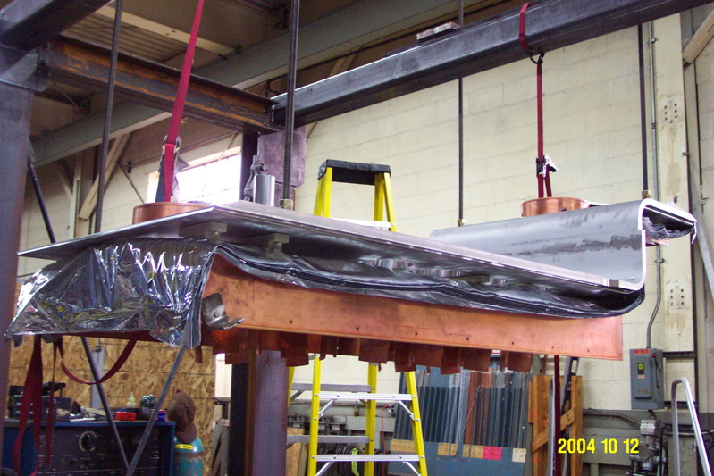
Build from top plate, down
Ram C. Dhuley | USPAS Cryogenic Engineering (Jun 21 - Jul 2, 2021)

Slide 11
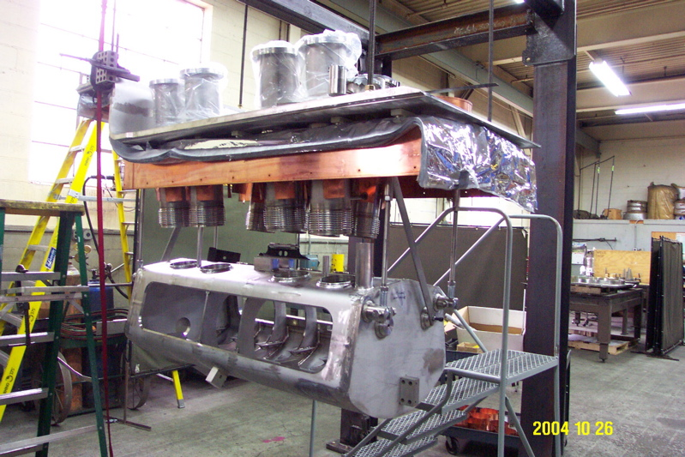
Hang helium vessel
Ram C. Dhuley | USPAS Cryogenic Engineering (Jun 21 - Jul 2, 2021)

Slide 12
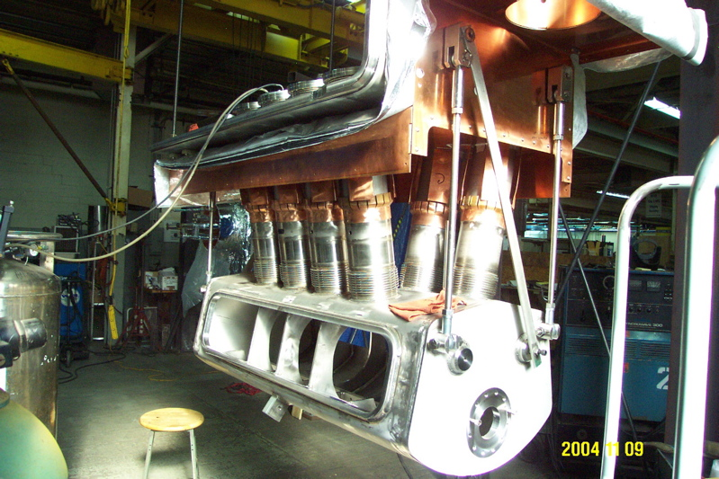
Connect helium vessel
Ram C. Dhuley | USPAS Cryogenic Engineering (Jun 21 - Jul 2, 2021)

Slide 13
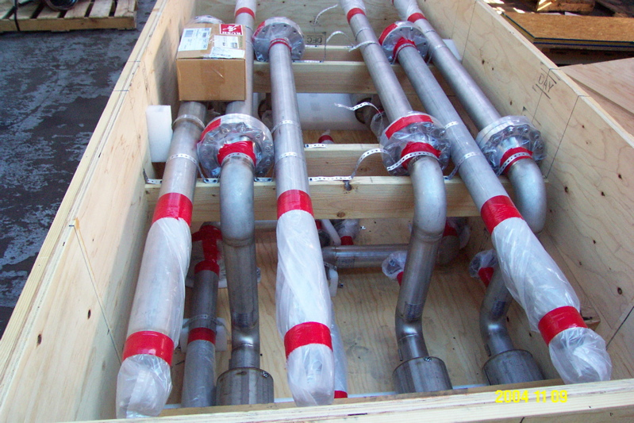
Prefabricated piping
Ram C. Dhuley | USPAS Cryogenic Engineering (Jun 21 - Jul 2, 2021)

Slide 14
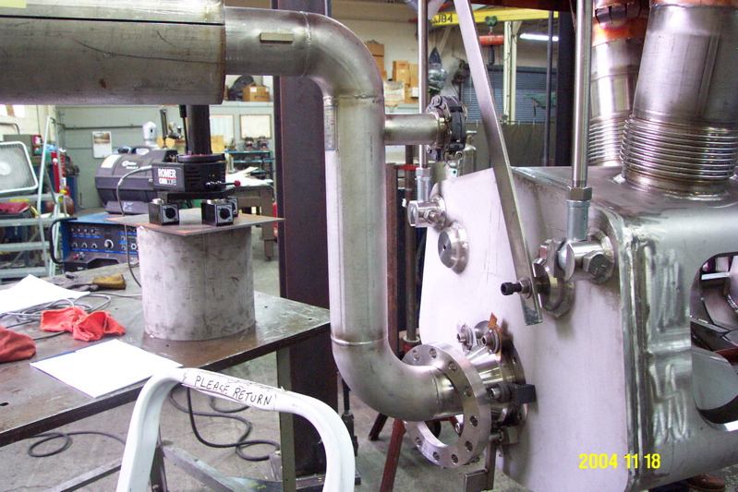
Install prefabricated piping
Ram C. Dhuley | USPAS Cryogenic Engineering (Jun 21 - Jul 2, 2021)

Slide 15
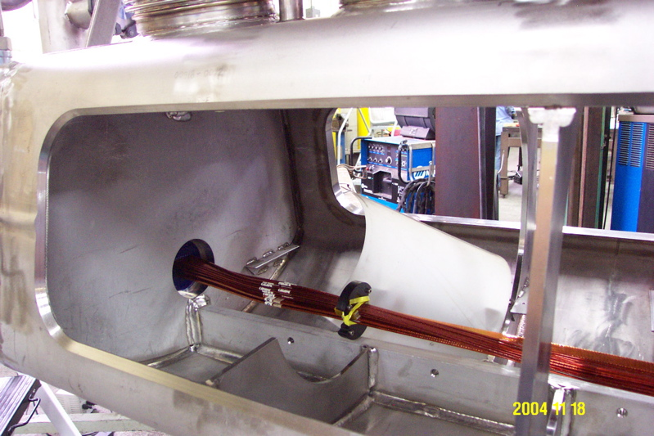
Splice and package internal cables
Ram C. Dhuley | USPAS Cryogenic Engineering (Jun 21 - Jul 2, 2021)

Slide 16
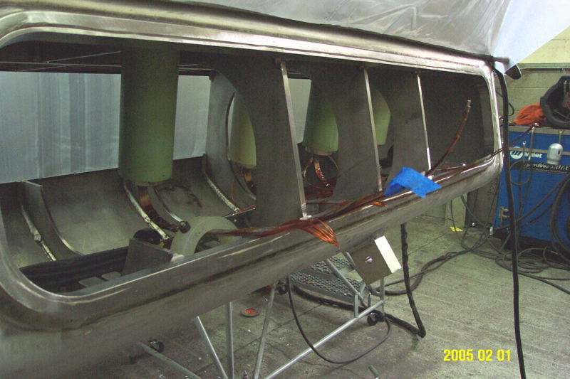
Splice and package internal cables
Ram C. Dhuley | USPAS Cryogenic Engineering (Jun 21 - Jul 2, 2021)

Slide 17
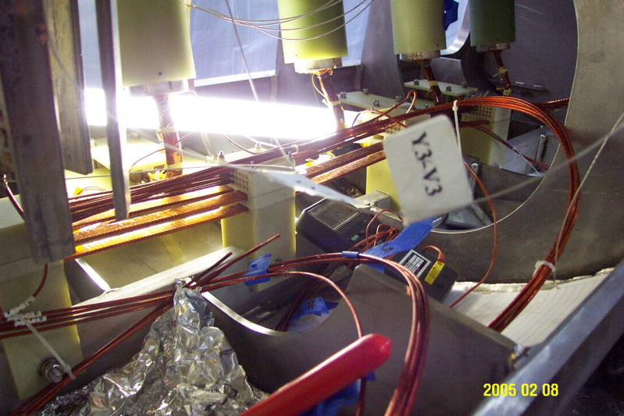
Splice and package internal cables
Ram C. Dhuley | USPAS Cryogenic Engineering (Jun 21 - Jul 2, 2021)

Slide 18
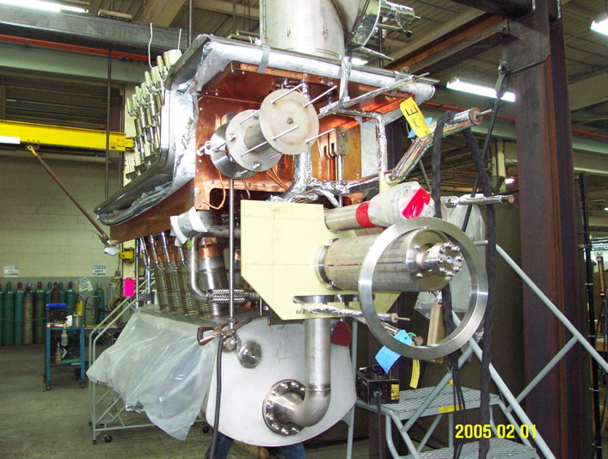
Install remaining internal piping
Ram C. Dhuley | USPAS Cryogenic Engineering (Jun 21 - Jul 2, 2021)

Slide 19
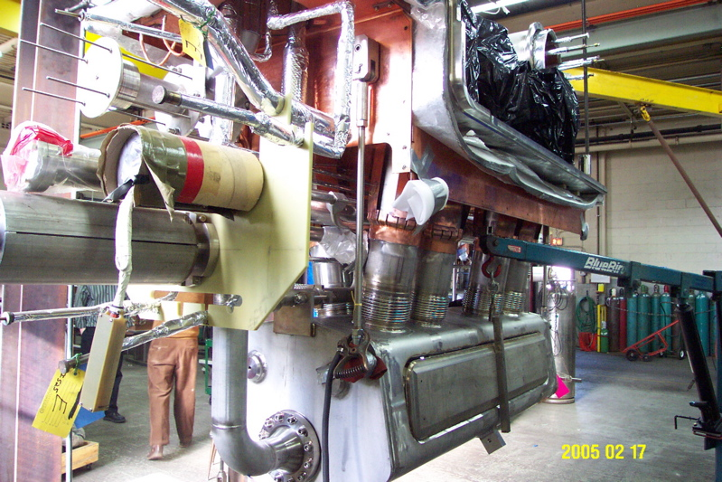
Weld close helium vessel
Ram C. Dhuley | USPAS Cryogenic Engineering (Jun 21 - Jul 2, 2021)

Slide 20
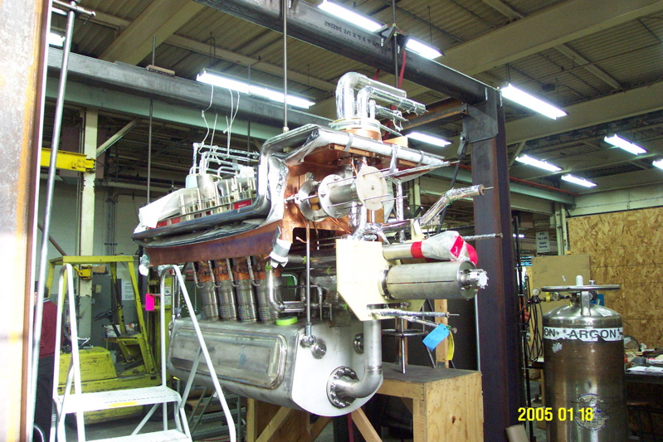
Leak check helium vessel
Ram C. Dhuley | USPAS Cryogenic Engineering (Jun 21 - Jul 2, 2021)

Slide 21
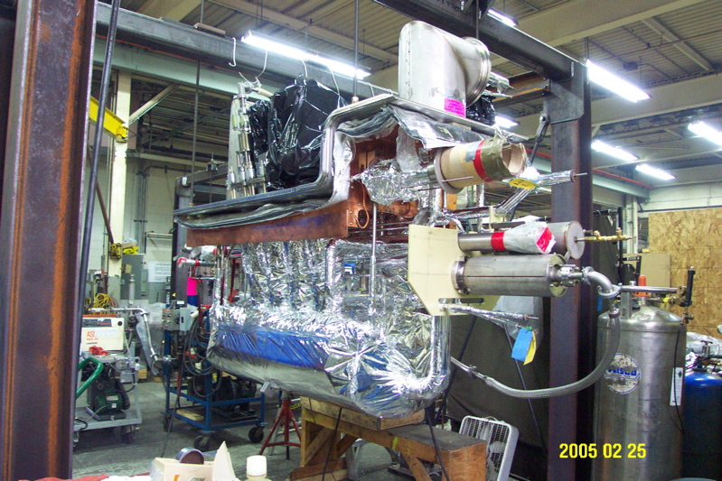
Wrap with multilayer insulation (MLI)
Ram C. Dhuley | USPAS Cryogenic Engineering (Jun 21 - Jul 2, 2021)

Slide 22
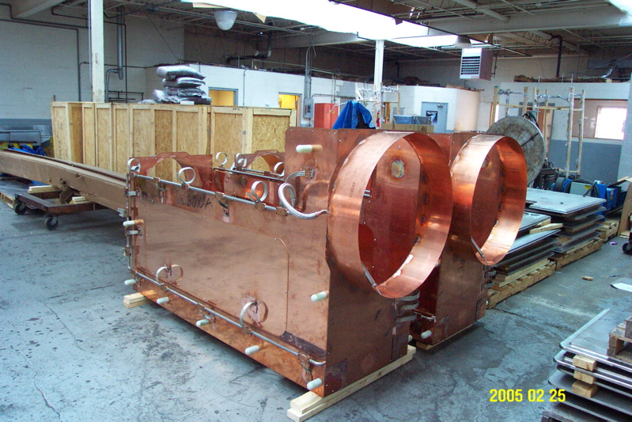
Prefabricated thermal shields
Ram C. Dhuley | USPAS Cryogenic Engineering (Jun 21 - Jul 2, 2021)

Slide 23
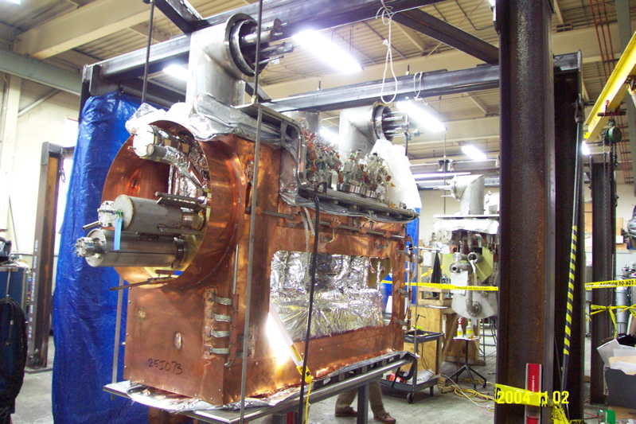
Install thermal shields
Ram C. Dhuley | USPAS Cryogenic Engineering (Jun 21 - Jul 2, 2021)

Slide 24
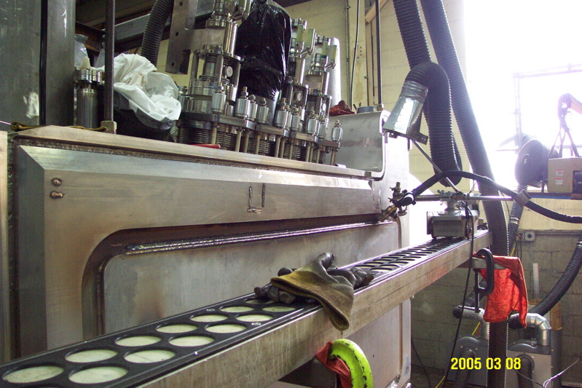
Weld vacuum shell
Ram C. Dhuley | USPAS Cryogenic Engineering (Jun 21 - Jul 2, 2021)

Slide 25
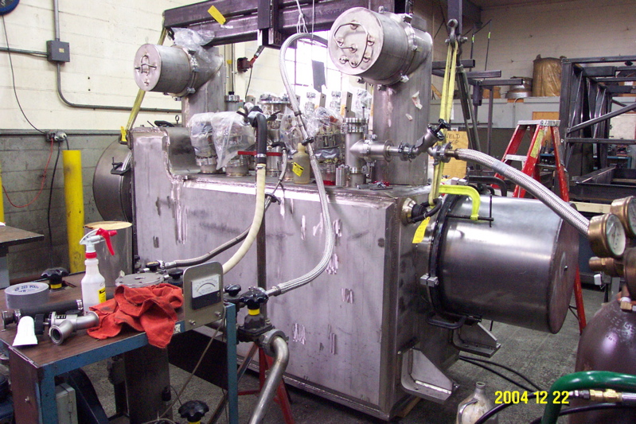
Final leak check and inspection
Ram C. Dhuley | USPAS Cryogenic Engineering (Jun 21 - Jul 2, 2021)

Slide 26
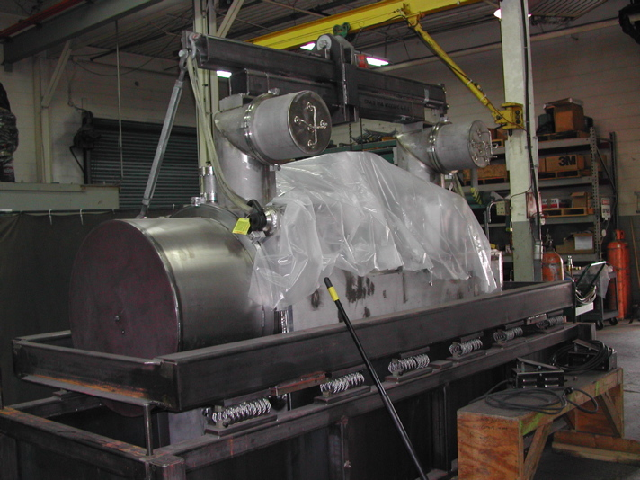
Shock-absorbing shipping frame
Ram C. Dhuley | USPAS Cryogenic Engineering (Jun 21 - Jul 2, 2021)

Slide 27
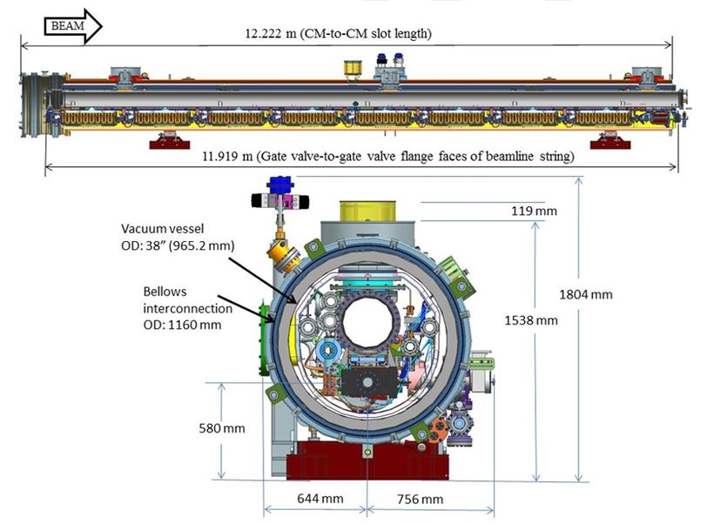
Photo story 2 – Assembly of LCLS II SRF cryomodule (pictures from FNAL and Jlab)
Ram C. Dhuley | USPAS Cryogenic Engineering (Jun 21 - Jul 2, 2021)

Slide 28
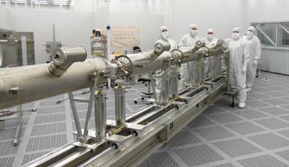
Cavity string – Jlab cleanroom
Ram C. Dhuley | USPAS Cryogenic Engineering (Jun 21 - Jul 2, 2021)

Slide 29
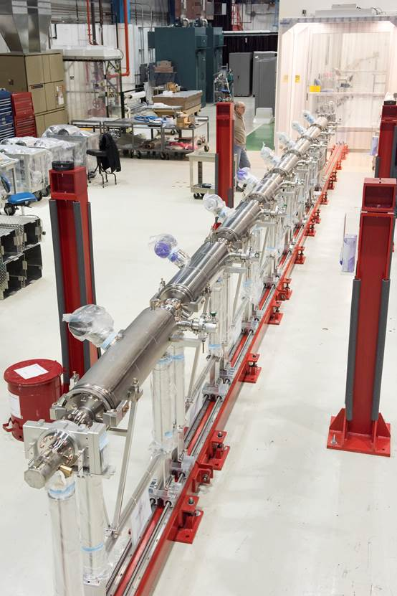
Cavity string out of cleanroom (Fermilab)
Ram C. Dhuley | USPAS Cryogenic Engineering (Jun 21 - Jul 2, 2021)

Slide 30
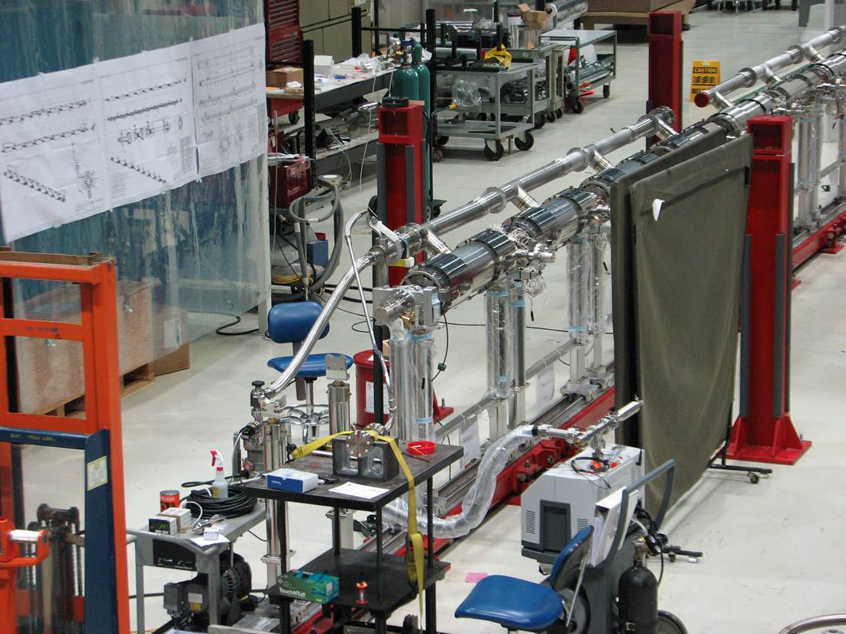
Welding and leak checking cryogenic pipes
Ram C. Dhuley | USPAS Cryogenic Engineering (Jun 21 - Jul 2, 2021)

Slide 31
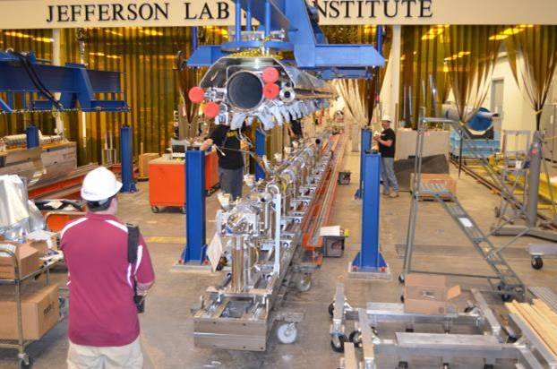
Attaching cavity string to cryogenic structure
Ram C. Dhuley | USPAS Cryogenic Engineering (Jun 21 - Jul 2, 2021)

Slide 32
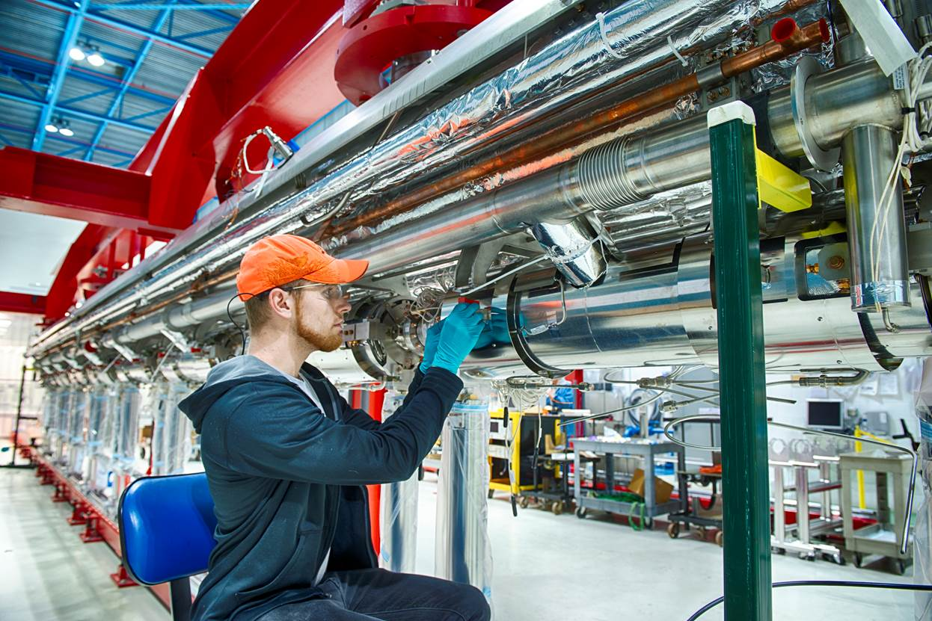
Integration of cavity string with cryogenic pipes and supports
Ram C. Dhuley | USPAS Cryogenic Engineering (Jun 21 - Jul 2, 2021)

Slide 33
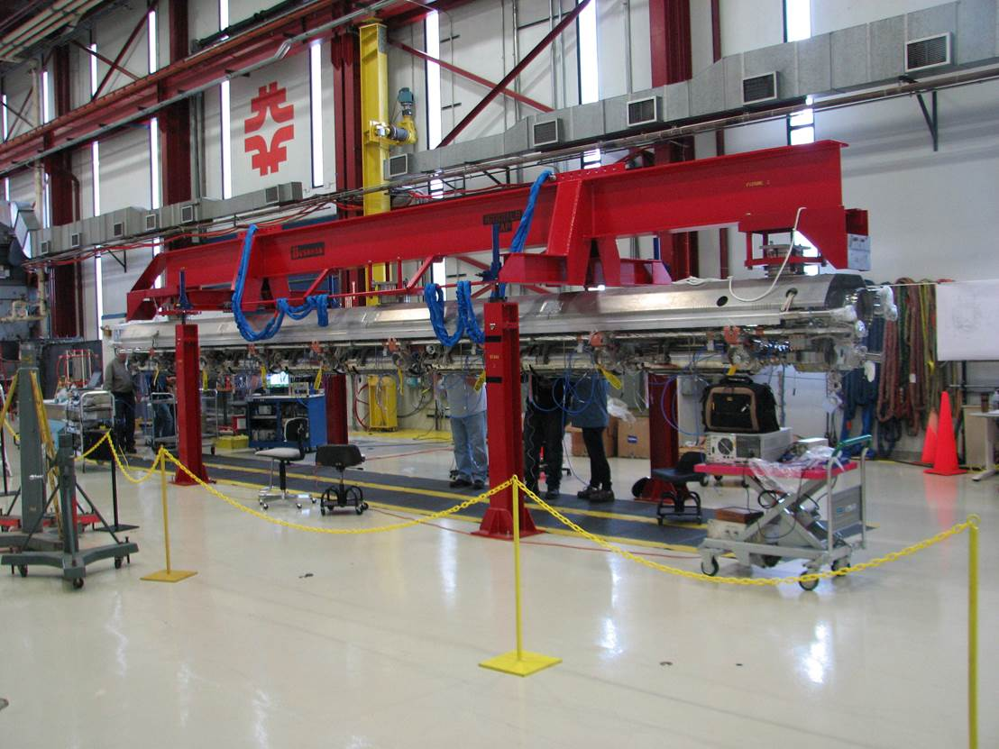
Assembly at alignment and instrumentation station
Ram C. Dhuley | USPAS Cryogenic Engineering (Jun 21 - Jul 2, 2021)

Slide 34
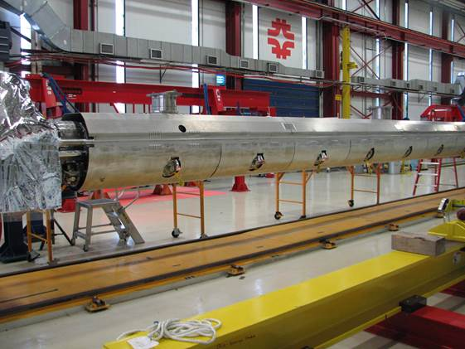
Thermal shield installed
Ram C. Dhuley | USPAS Cryogenic Engineering (Jun 21 - Jul 2, 2021)

Slide 35
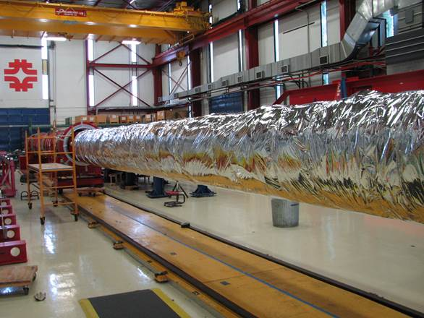
Multilayer insulation wrapped
Ram C. Dhuley | USPAS Cryogenic Engineering (Jun 21 - Jul 2, 2021)

Slide 36
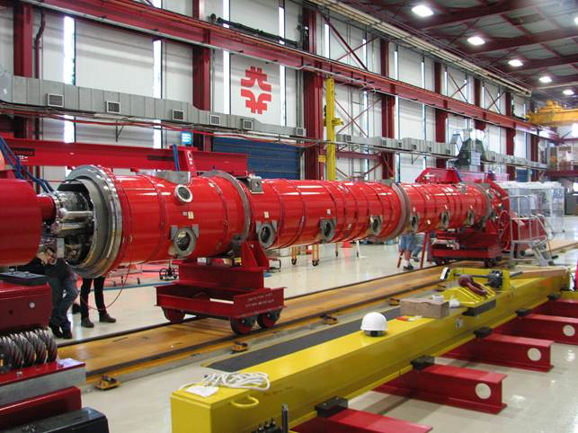
Assembly into vacuum vessel
Ram C. Dhuley | USPAS Cryogenic Engineering (Jun 21 - Jul 2, 2021)

Slide 37
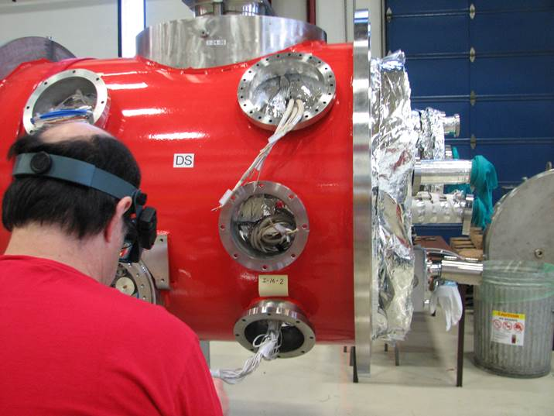
Instrumentation wiring
Ram C. Dhuley | USPAS Cryogenic Engineering (Jun 21 - Jul 2, 2021)

Slide 38
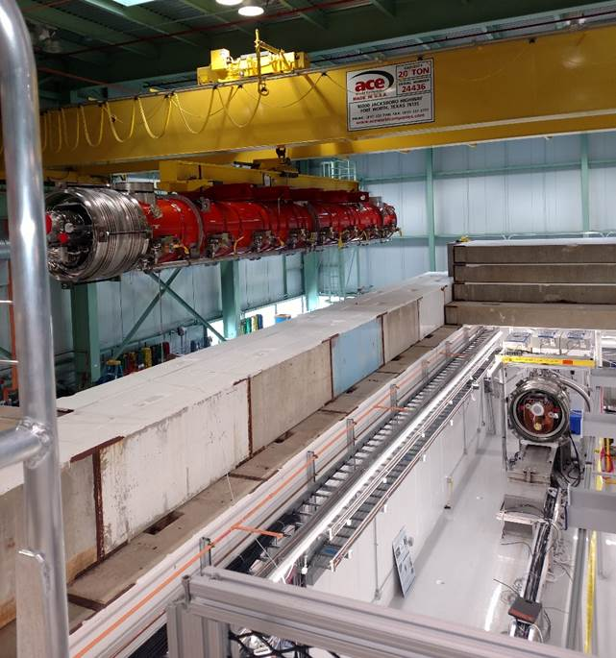
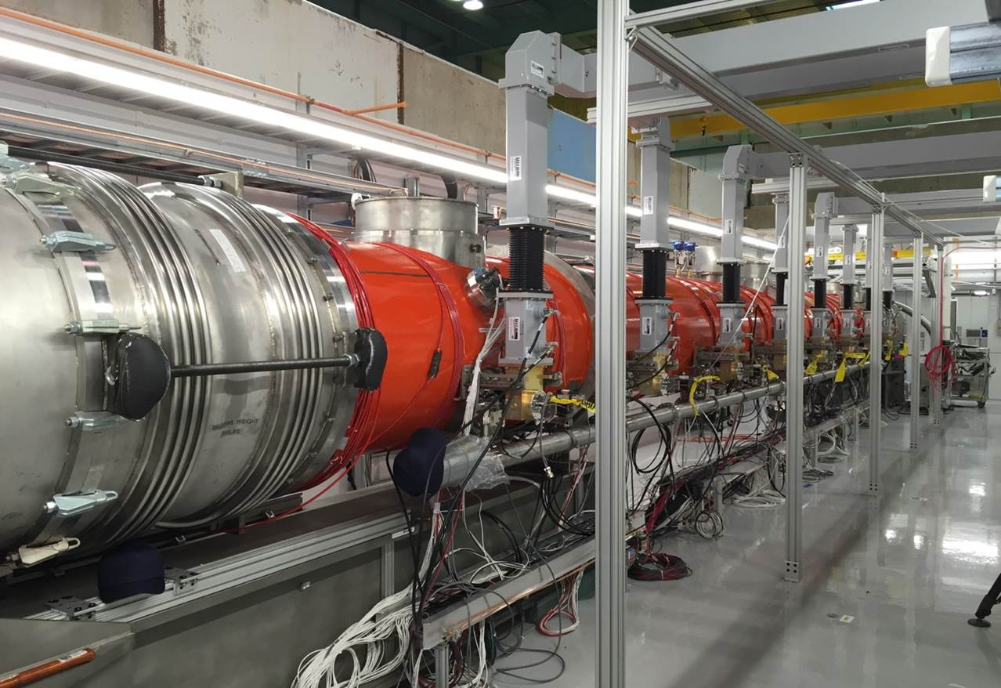
Final cryomodule assembly
Ram C. Dhuley | USPAS Cryogenic Engineering (Jun 21 - Jul 2, 2021)

